Slide 1
Production
Production Completion Entry
& Post
DMS Guide

Slide 2
Table of Contents
Step 1 - Production Completion Entry........................................................................3
Step 2 - Production Completion Post........................................................................11

Slide 3
Step 1 – Production Completion Entry
Back to the Table of Contents

Slide 4
Production Completion Entry
The Production Completion Entry resource is part of the production completion entry procedure, which is a step in the Production process.
Through this resource you can enter the results of a production run with reference to an existing work order.
More specifically, you will be able to finalize the transactions of a work order (previously created in the DMS).

Slide 5
Production Completion Entry
Via the "Release to Post" action, this will allow the inventory to be released into the system.
  This action is used to allow a completed work order to be available for Production Completion Post. When an on-demand production work order is needed to fulfill an outbound transaction, the Release to Post action will allocate the produced item to the outbound order, warehouse transfer, or work order to which it is referenced.
  Once a work order is successfully completed and released to post, the quantity to stock is added to the quantity on hand of the BOM item produced, and the quantity used is subtracted from the quantity on hand for each component.

Slide 6
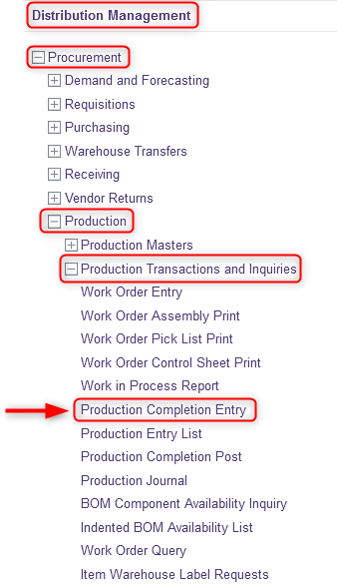
Production Completion Entry
With a desktop computer, use the Distribution Management menu.
Select the Procurement resource.
Under Procurement, click on Production.
Under Production, click on Production Transactions and Inquiries.
Under Production Transactions and Inquiries, click on Production Completion Entry.

Slide 7
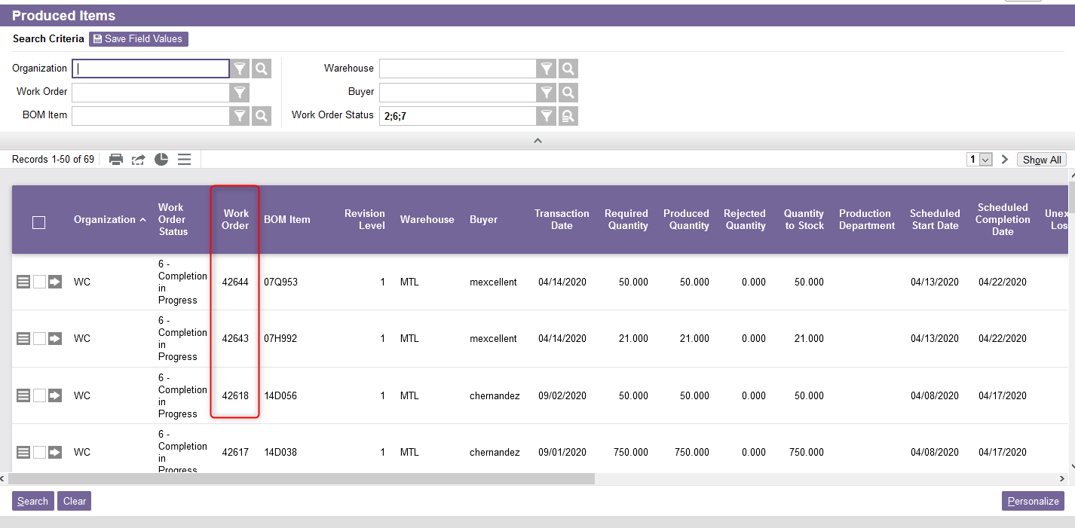
Production Completion Entry
Click enter in one of the search criteria fields. The list of all work order records will appear.

Slide 8
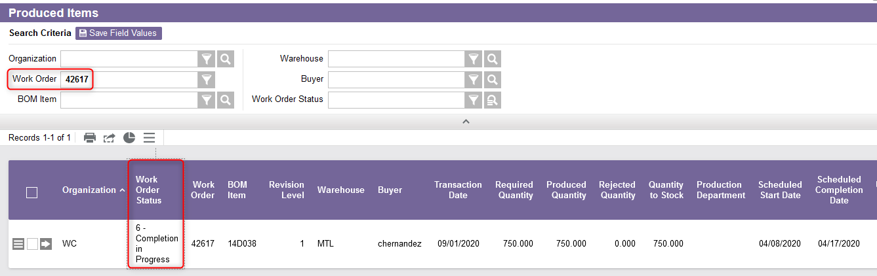
Production Completion Entry
Retrieve the desired record. The record must have a “6 - Completion in Progress” status.

Slide 9
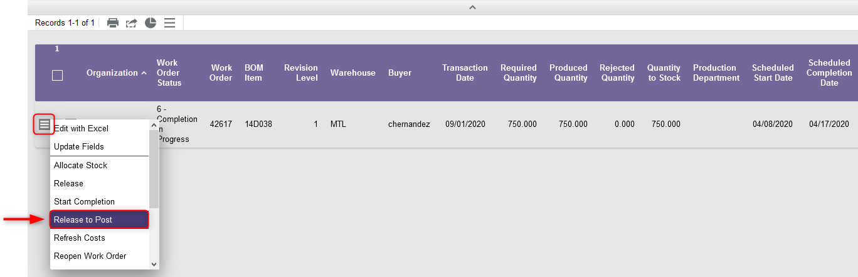
Production Completion Entry
Click on the Use Record as Criteria for Action button and select the Release to Post action.

Slide 10
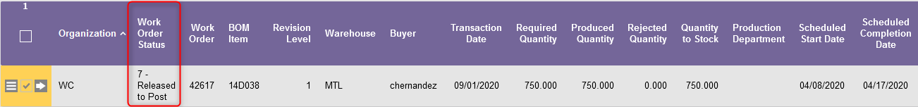
Production Completion Entry
Once the "Release to Post" action has been selected:
  The status of the Work Order will change to "7 – Released to Post“ and the work order can no longer be modified or canceled.
  Inventory has been impacted, that is, the system will generate the inventory of the finished product, and the financial transaction records are ready to be posted using Production Completion Post.
  You can proceed with the Step 2 – Production Completion Post

Slide 11
Step 2 – Production Completion Post
Back to the Table of Contents

Slide 12
Production Completion Post
The Production Completion Post resource:
  Represents the last step in the work order process,
  Processes the work orders requested as long as their status is “7 - Released to Post”,
  Posts any inventory variances that were recorded. The variance value is based on the current G/L cost of the item.
In other words, this resource is used to close a work order in the system.

Slide 13
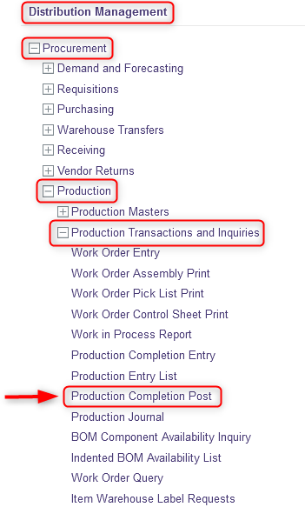
Production Completion Post
With a desktop computer, use the Distribution Management menu.
Select the Procurement resource.
Under Procurement, click on Production.
Under Production, click on Production Transactions and Inquiries.
Under Production Transactions and Inquiries, click on Production Completion Post.

Slide 14
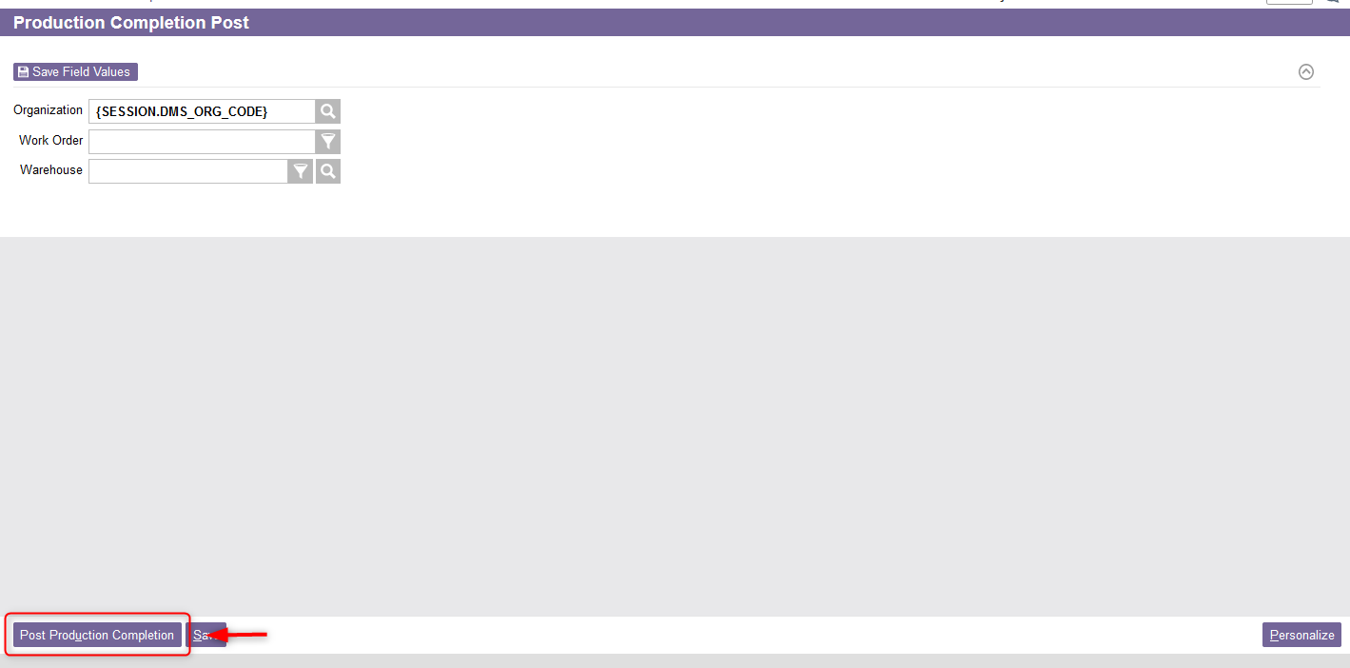
Production Completion Post
From the Production Completion Post resource, click on Post Production Completion to process your request.

Slide 15
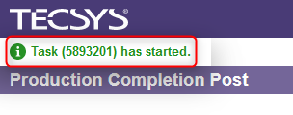
Production Completion Post
A confirmation message will appear.
Click on Close to exit the Production Completion Post resource.

